Slide 1

NodeJS

Slide 2
Objectives
Introduction to NodeJS
Features Of Node.Js
Single Threaded but Highly Scalable
Event-driven and Asynchronous
Event Loop What is FullStack?
Node.Js - Environment Setup
Setting up Node.js and NPM
Basics of Node.js and NPM
Node.Js - First Application

Slide 3
What is Node.JS?
Node.js is a tool for building quick and scalable network applications based on Chrome's JavaScript runtime, ideal for data-intensive real-time applications.
Node.js is an open source, cross-platform runtime environment.
Node.js = Runtime Environment + JavaScript Library.

Slide 4
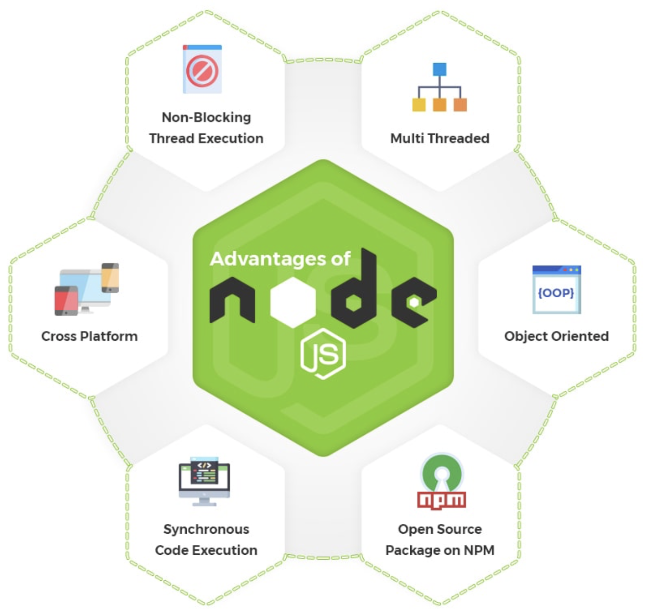
Features of Node.JS
Event-driven and Asynchronous
Very Fast
Single Threaded but Highly Scalable
No Buffering
License
Notes:
Event-driven and Asynchronous
Node.js-based server never awaits the delivery of data from an API.
After accessing an API, the server moves on to the next one, and a Node.js notification mechanism called Events enables the server to get t response before moving on to the next API
Very Fast
The V8 JavaScript Engine in Google Chrome, which powers the Node.js framework, makes it extremely quick to execute code.
Single Threaded but Highly Scalable
The event mechanism enables the server to respond in a non-blocking manner and increases the server's scalability
No Buffering
Data is never buffered in Node.js applications.
These programs merely output the data in sections.
License
Node.js is distributed under the MIT license.

Slide 5
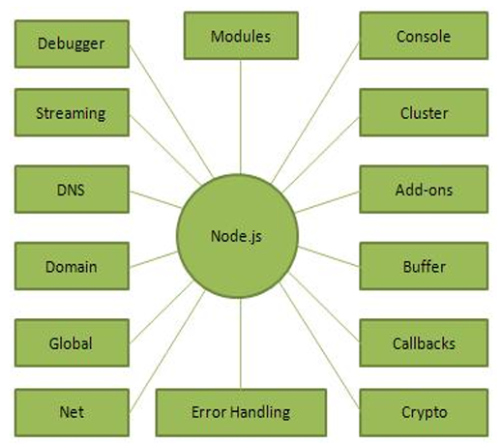
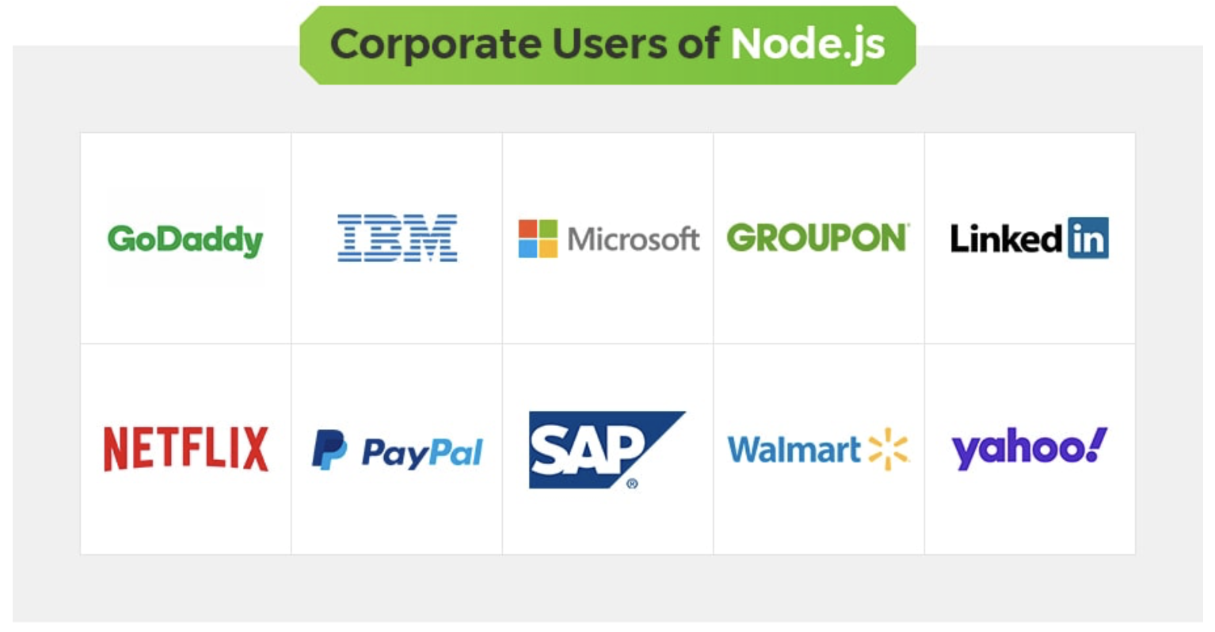
Who uses Node.JS?

Slide 6
Where to and not to use Node.JS?
Some areas where Node.js is demonstrating why it makes a great technological partner.
Applications with I/O bound.
Applications for streaming data.
Real-time Data-Intensive Applications (DIRT).
Applications built on JSON APIs.
Applications with a single page.
Node.js should not be used for CPU-intensive applications

Slide 7
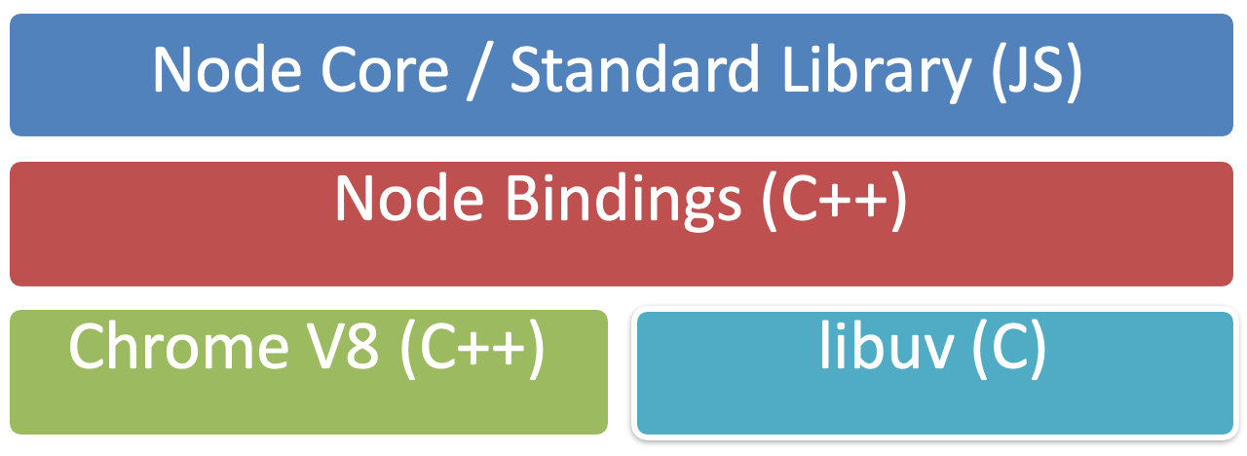
Node Architecture

Slide 8
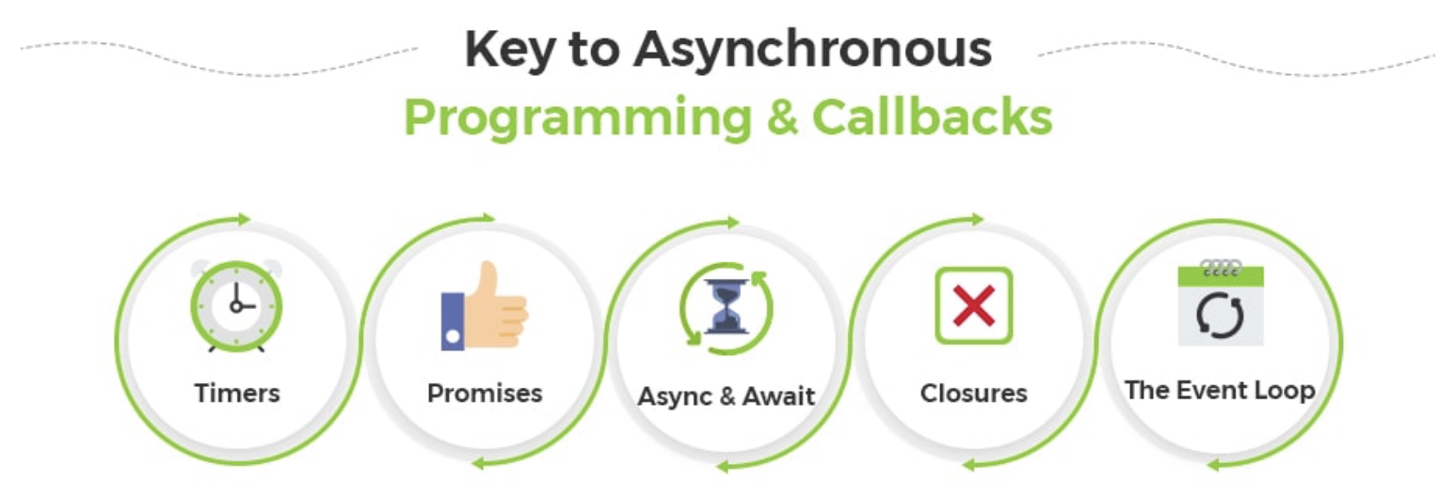
Why Node.JS?
Node.js eliminates the waiting, and simply continues with the next request.
Node.js runs single-threaded, non-blocking, asynchronous programming, which is very memory efficient.

Slide 9
Why Node.JS? - 2
How traditional server handles a file request | How Nodejs handles a file request
Transmits the task to the file system on the computer Wait until the opens and begins reading it. Gives the client their content back. Prepared to tackle the next request | Transmits the task to the file system on the computer. Prepared to manage the next request. The server sends the content to the client after the file system has opened and read the file.

Slide 10
What can Node.JS do?
Node.js is capable of producing dynamic page content.
On the server, Node.js can create, open, read, write, remove, and close files.
Node.js can gather data from forms.
Your database's data can be added, deleted, or modied by Node.js.

Slide 11
Node.js Use Cases
Utilities written in JavaScript for web development:
Bower, Grunt, Gulp, Yeoman etc.
Server-side Development
Web server, Business logic, Database access

Slide 12
Node Package Manager (NPM)
Node package manager (NPM): manages ecosystem of node modules / packages
A package contains:
JS files
package.json (manifest)

Slide 13
package.json
A package.json file affords you a lot of great things:
It serves as documentation for what packages your project depends on.
It allows you to specify the versions of a package that your project can use using semantic versioning rules.
Makes your build reproducible, which means that its way easier to share with other developers.
Source: https://docs.npmjs.com/getting-started/using-a-package.json

Slide 14
Exercise: Setting up a NodeJS Application

Slide 15
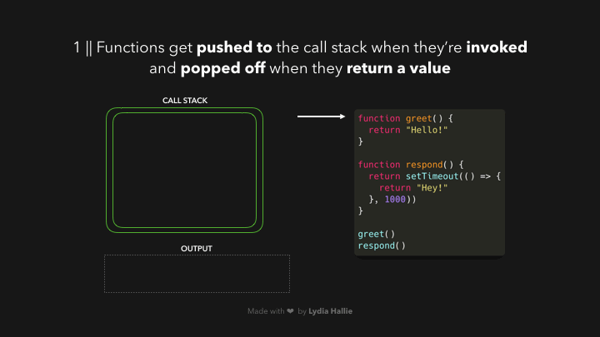
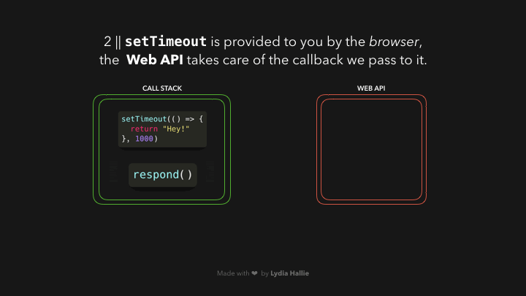
Event Loop
The event loop allows Node.js to perform non-blocking I/O operations despite JavaScript's single-threaded nature by offloading duties to the system kernel wherever possible.

Slide 16
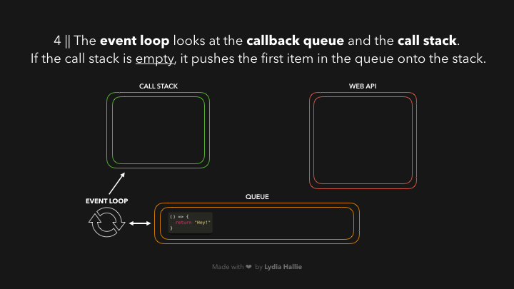
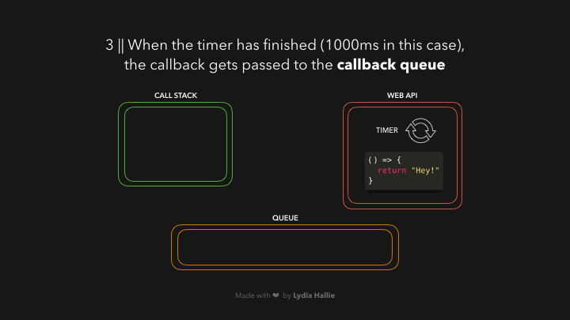
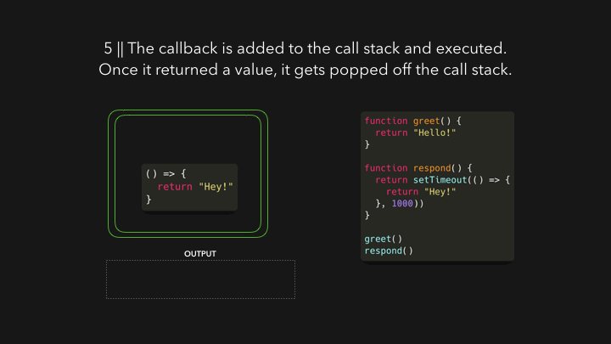
Event Loop – cont’d

Slide 17
Event Loop and Emitters
Node.js offers events and callbacks to let users accomplish this. The event loop is an infinite loop that, after searching the event queue for any triggered events, executes those that are discovered and deletes them from the queue.

Slide 18
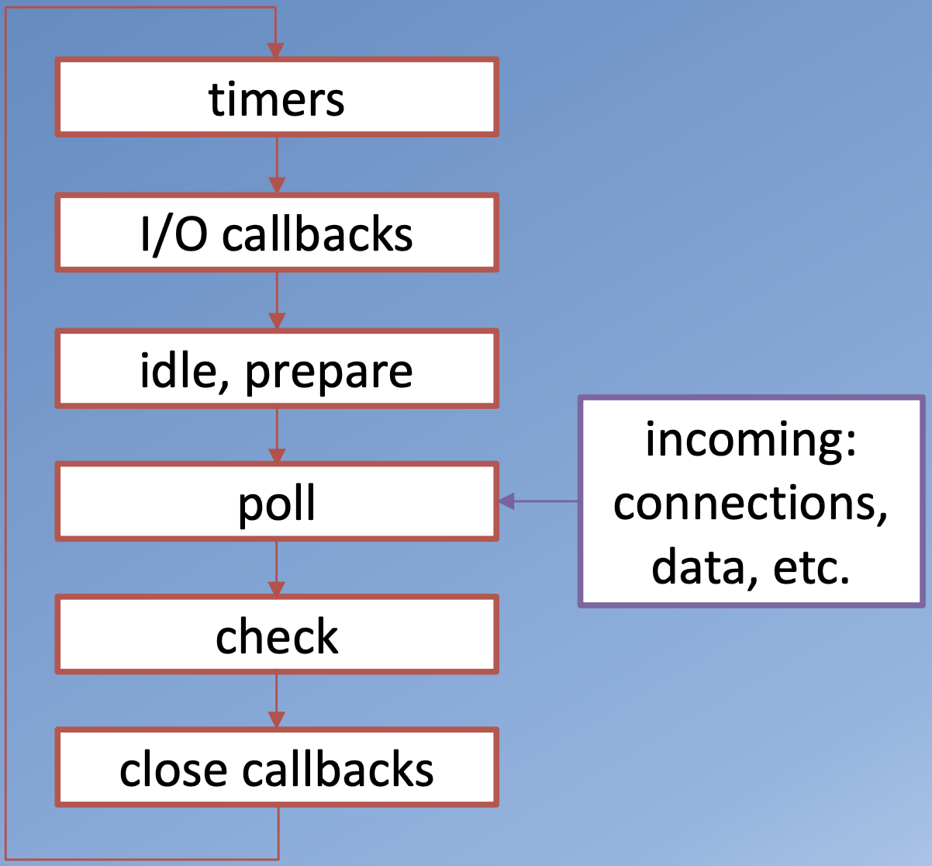
Event Loop and Emitters – cont’d
Phases in Event Loop
1. Timers: The setTimeout() and setInterval()-scheduled callbacks are executed at this stage. Timer callbacks are created by the setTimeout() and setInterval() functions, and they attempt to run as soon as the specified time has eclapsed
2. Pending Callbacks: The deferred callbacks' execution happens at this stage.
3. Poll: It executes I/O callbacks and fetches fresh I/O events.
4. Check: Here, setImmediate() callbacks are triggered.
5. Close callbacks: Socket.on ('close'), for example, is one of the close callbacks.

Slide 19
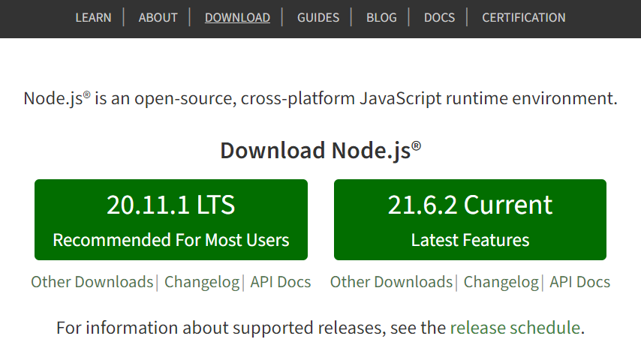
Enviroment Setup
Link Download and Install NodeJS: https://nodejs.org/
Node Package Manager (NPM) offers two primary features:
Node.js packages and modules' online repositories, searchable via search.nodejs.org.
A command-line tool for managing Node.js package dependencies, version control, and installation.
A package contains:
JS files
package.json (manifest)
npm –version
package.json
is used to specify a package's properties
Initializing package.json
To initialize a package.json file for your project, type at the prompt in your project directory:
npm init
Follow along and answer the prompts to initialize

Slide 20
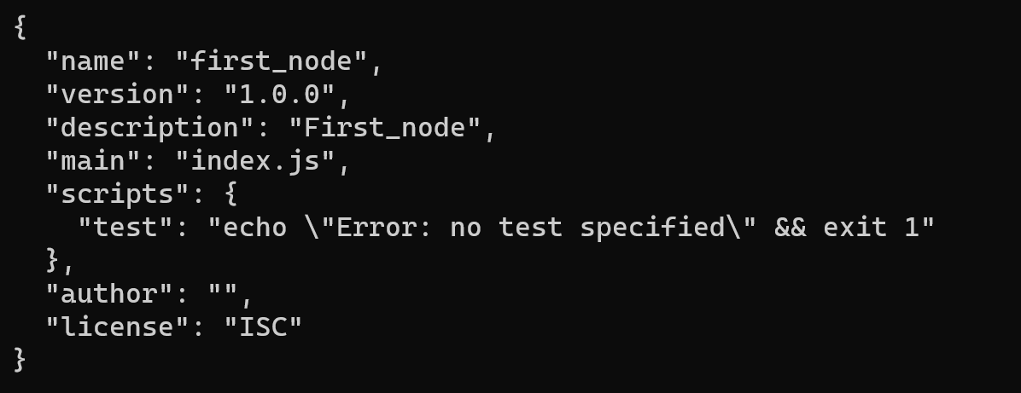
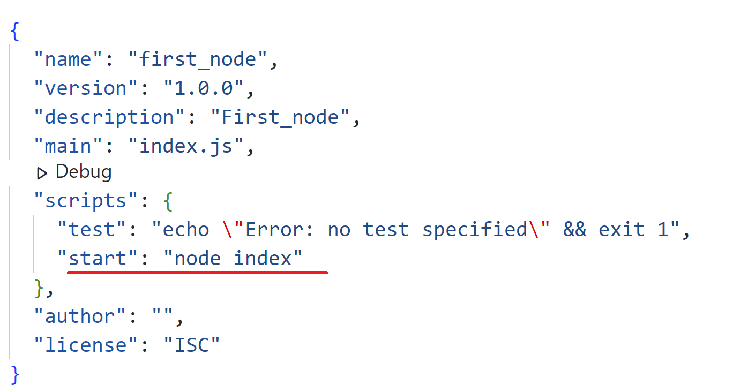
Node.JS – First Application
Npm init
Index.js: write function solveLinearEquation and solveQuadraticEquation with ES6 (javascript)

Slide 21
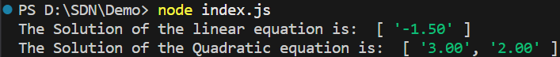
Node.JS – First Application – 2
const solveLinearEquation = (a, b) => {
if (a === 0) {
if (b === 0) {
return "The equation has infinitely many solution";
}
else {
return "The equation has np solution"
}
}
else{
let x = -b/a;
return [x.toFixed(2)];
}
}
const solveQuadraticEquation = (a, b, c) => {
const delta = b * * 2 - 4 * a * c;
if (a == 0) return solveLinearEquation(b, c);
if (delta < 0) return "The equation has no real solution";
else if (delta === 0) {
let x = -b / (2 * a);
return [x.toFixed(2)];
}
else {
let x1 = (-b + Math.sqrt(delta)) / (2 * a);
let x2 = (-b - Math.sqrt(delta)) / (2 * a);
return [x1.toFixed(2), x2.toFixed(2)];
}
}
console.log(`The Solution of the linear equation is: `,solveLinearEquation(2,3));
console.log(`The Solution of the Quadratic equation is: `, solveQuadraticEquation(1,-5,6));

Slide 22
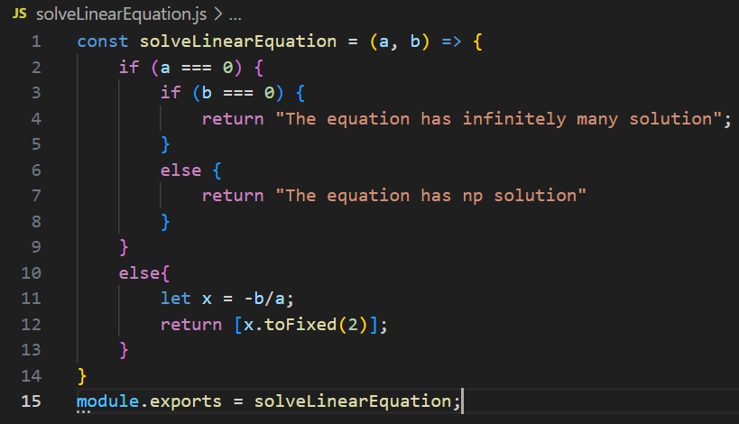
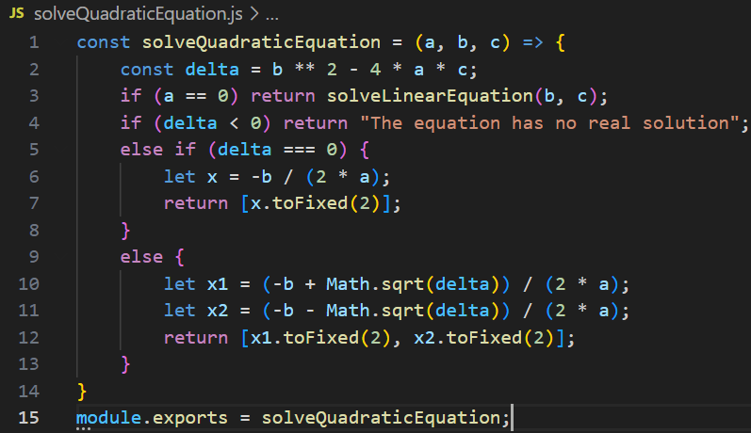
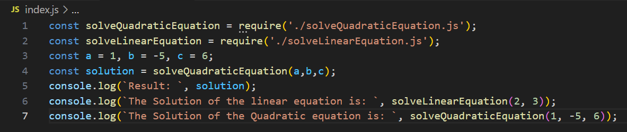
Node.JS – First Application – 3
Write a simple Node module

Slide 23
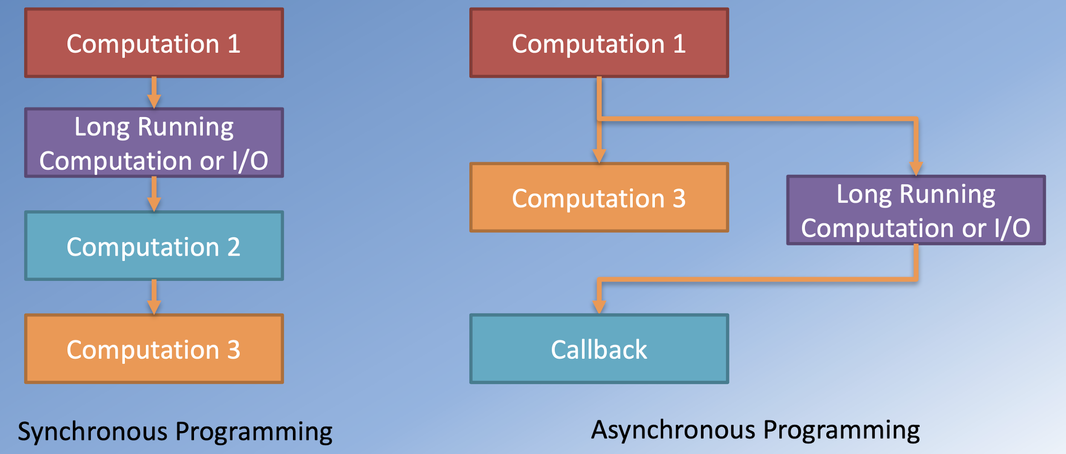
Node.JS – CallBacks

Slide 24
Node.JS – CallBacks Concept
A call-back is a function's asynchronous replacement.
Once a task is finished, a call-back function is called.
Call-backs are used frequently by Node.
Call-backs are supported by all of Node's APIs because of the way they were developed

Slide 25
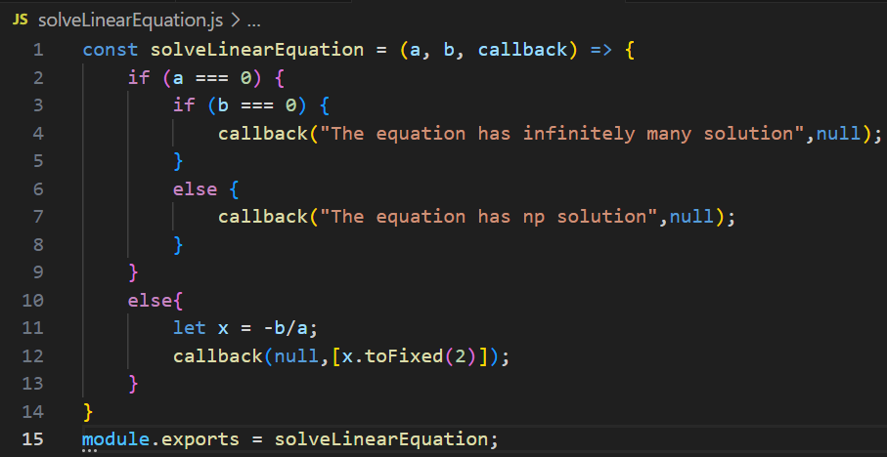
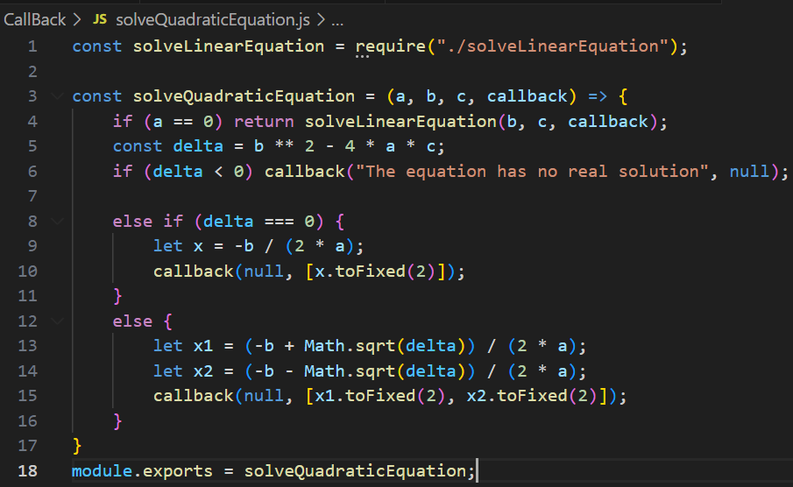
Node.JS – CallBacks Concept – 2

Slide 26
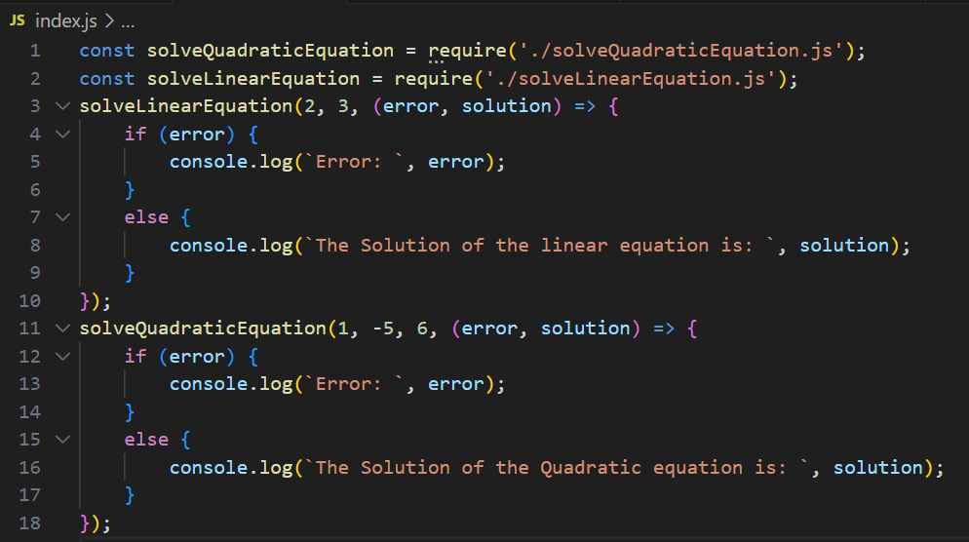
Node.JS – CallBacks Concept – 3

Slide 27
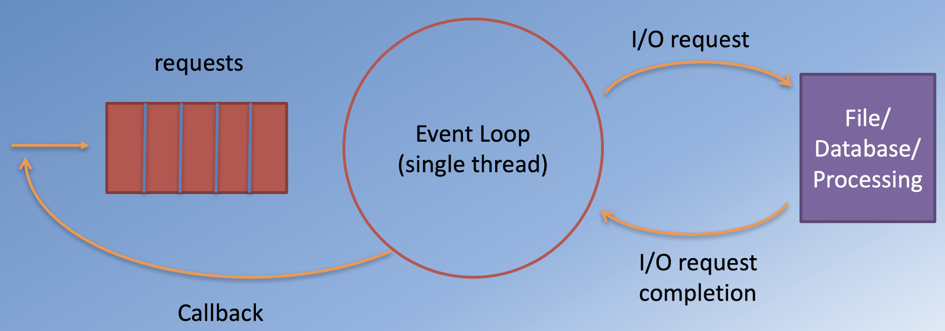
Node, Async I/O and Callbacks

Slide 28
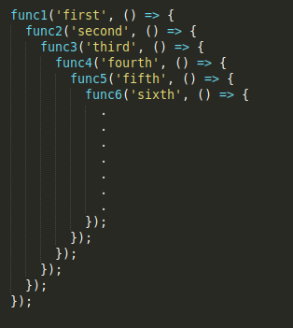
Why using Promise?
Asynchronous JavaScript, or JavaScript that uses callbacks, is hard to get right intuitively => callback hell
The shape of the resulting code structure resembles a pyramid and hence callback hell is also called the “pyramid of the doom”.
It makes the code very difficult to understand and maintain.

Slide 29
What is Promise?
A promise is an object with a syntactical coating introduced by ES6 which became another way of skipping writing callbacks to implement asynchronous operations.
Web APIs like fetch() are implemented using the promising methodology.
It makes the code more readable and is a solution to escape the callback hell.
A JavaScript Promise object can be:
Fulfilled: the desired action has been resolved or completed successfully.
Pending : the desired action has neither been resolved nor been rejected and still in its initial state.
Rejected : the desired action has been rejected causing the desired operation to fail.

Slide 30
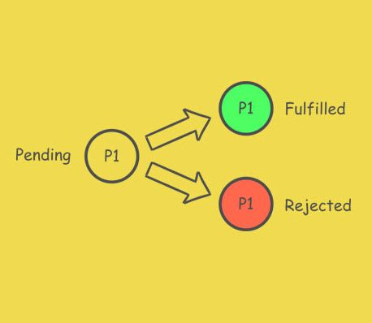
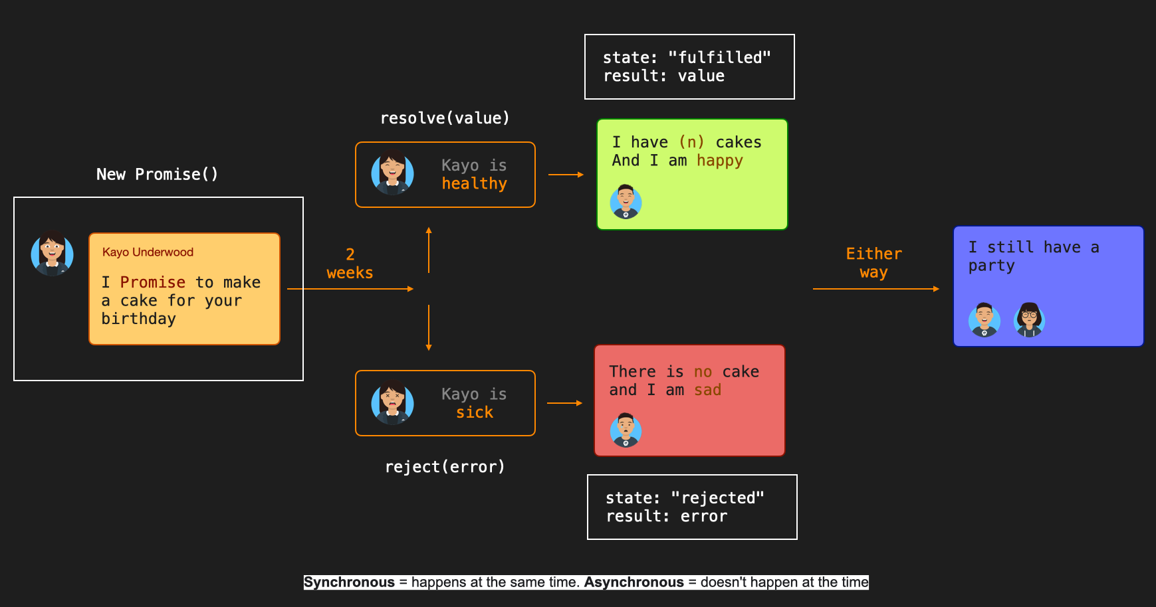
What is Promise? – 2
The Promise object supports two properties: state and result.

Slide 31
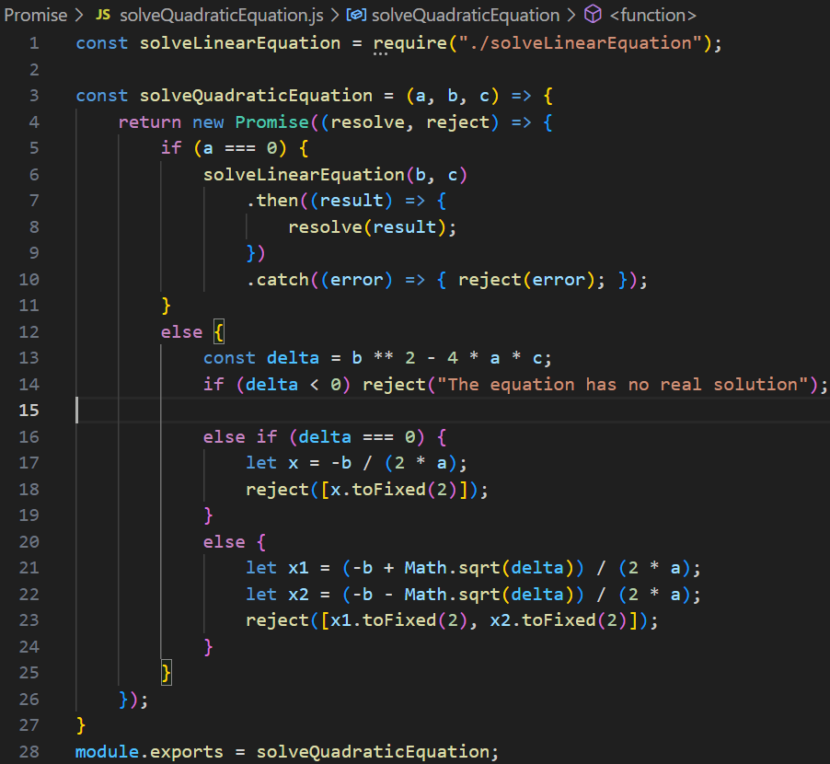
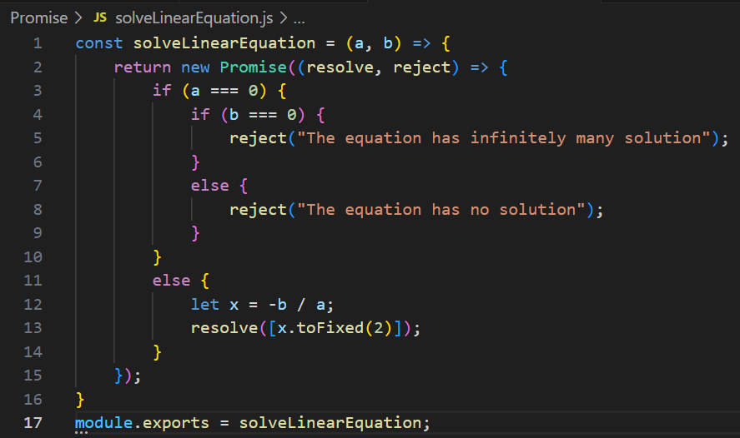
What is Promise? – 3

Slide 32
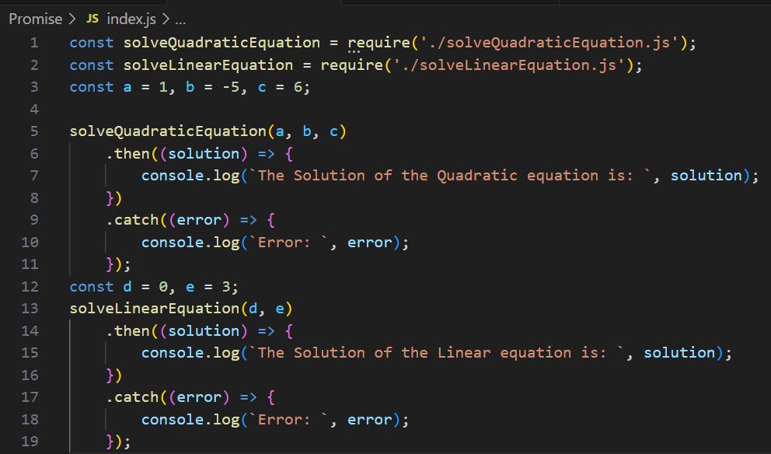
What is Promise? – 4

Slide 33
Async/Await
This is the second method to escape the callback hell.
It serves as a better way of approaching promises
It internally resolves promises as well as makes it easier for developers to write readable code.
The async function is made to stop its execution until a Promise() is either fulfilled or rejected. The function will resume only once the promise is settled. After it resumes, the value of the set of await expression will contain the value of the settled Promise().
await expression shows the rejected result if the Promise() gets rejected.

Slide 34
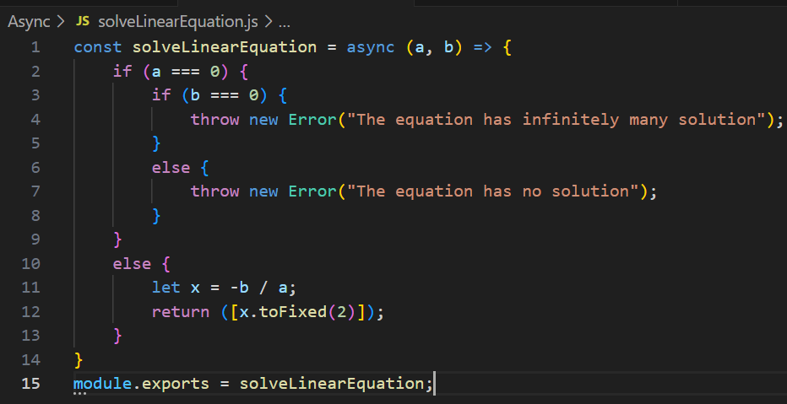
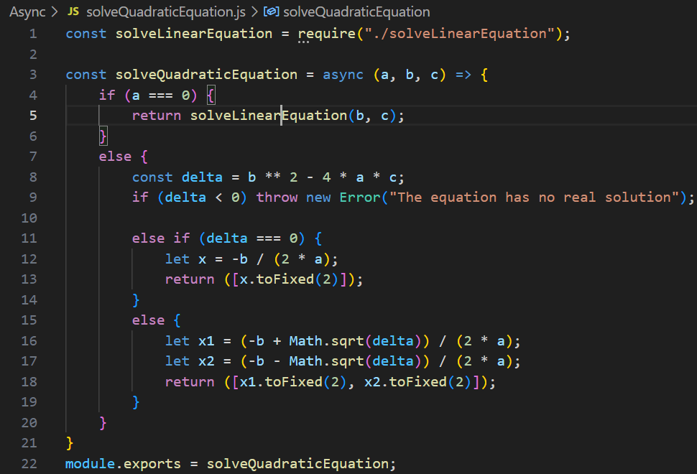
Async/Await - 2

Slide 35
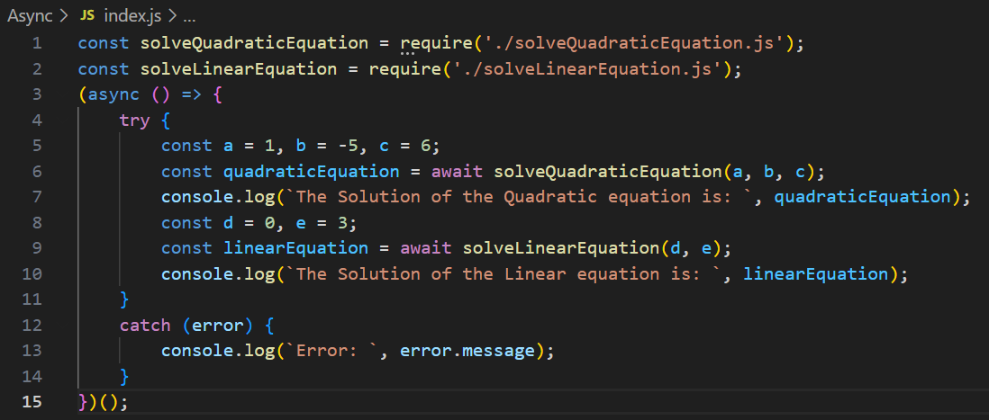
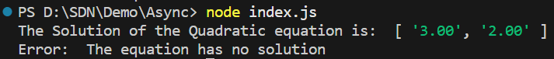
Async/Await - 3

Slide 36
Exercise: Using ES6

Slide 37
Summary
Concepts were introduced:
Introduction to NodeJS
Understand the download and install Node.js and NPM
Features Of Node.Js
Single Threaded but Highly Scalable
Event-driven and Asynchronous
Event Loop What is FullStack?
Node.Js - Environment Setup
Setting up Node.js and NPM
Basics of Node.js and NPM
Node.Js - First Application

